Slide 1
Unit II

Slide 2
Writing a Policy for Software Testing
A software testing policy serves two purposes.
it is the basis for defining what software testers will include in the test processes.
It explains to outside parties, such as organizational management, IT customers and users, as well as project personnel, the role and responsibilities of software testing.

Slide 3
Criteria for a Testing Policy
A testing policy involves the following four criteria:
Definition of testing: A brief but clear definition of testing.
Testing system: The method through which testing will be achieved and enforced.
Evaluation: How information services management will measure and evaluate testing
Standards: The standards against which testing will be measured.

Slide 4
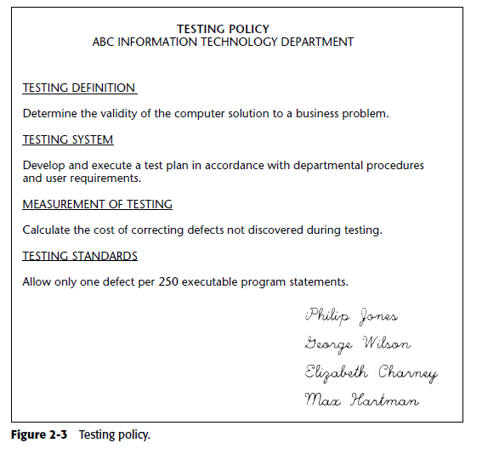

Slide 5
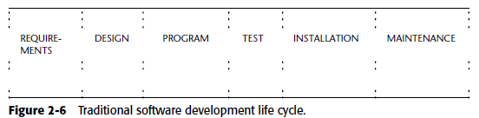

Slide 6
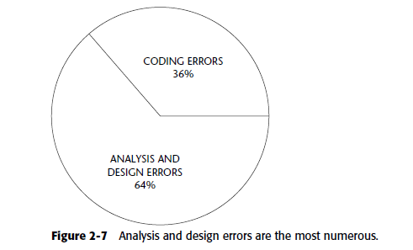

Slide 7
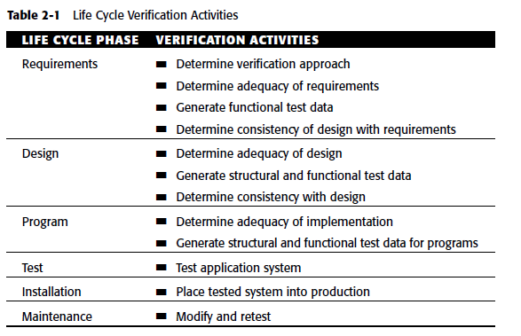

Slide 8
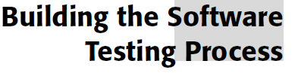

Slide 9
The testing process is the means by which the test strategy is achieved.
The team that develops the testing process uses the test strategy as the requirements for the process.

Slide 10
Software Testing Guidelines
Software testing should reduce software development risk.
Risk is present in all software development projects, and testing is a control that reduces those risks.
2. Testing should be performed effectively.
Testing should be performed in a manner in which the maximum benefits are achieved from the software testing efforts.
3. Testing should uncover defects.
Ideally, at the conclusion of testing there should be no defects in the software.

Slide 11
4. Testing should be performed using business logic.
Money should not be spent on testing unless it can be spent economically to reduce business risk. In other words, it does not make business sense to spend more money on testing than the losses that might occur from the business risk.
5. Testing should occur throughout the development life cycle.
Testing is not a phase, but rather a process. It begins when development begins and ends when the software is no longer being used.
6. Testing should test both structure and function.
Testing should test the functional requirements to ensure they are correct, and test the adequacy of the software structure to process those functional requirements in an effective and efficient manner.

Slide 12
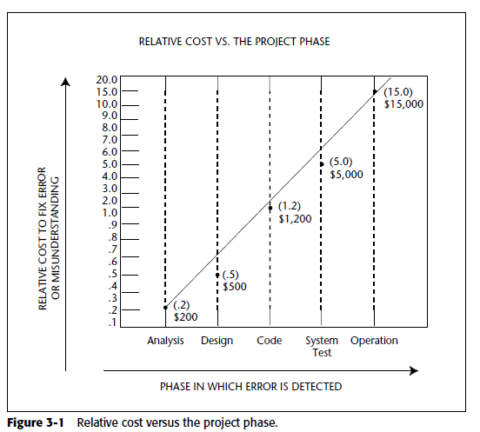

Slide 13
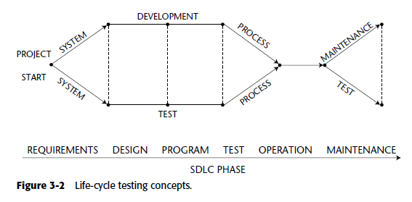

Slide 14
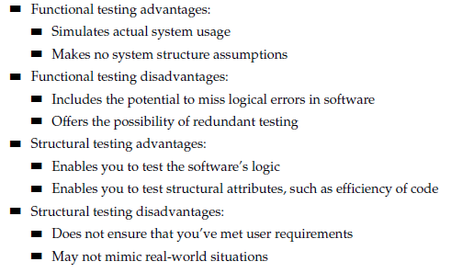

Slide 15
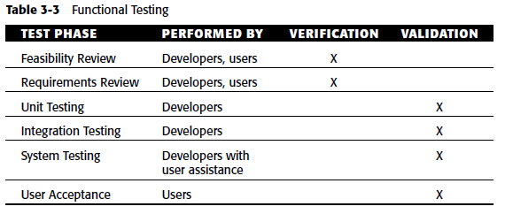

Slide 16
Workbench Concept
In IT organizations, workbenches are more frequently referred to as phases, steps, or tasks.
The workbench is a way of illustrating and documenting how a specific activity is to be performed.
Defining workbenches is normally the responsibility of a process management committee, which in the past has been more frequently referred to as a standards committee.

Slide 17
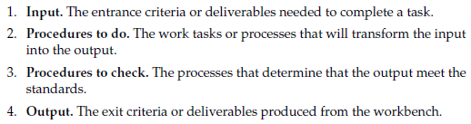

Slide 18
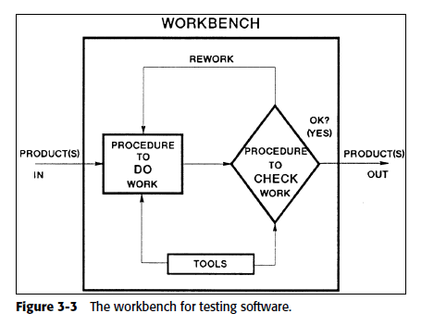

Slide 19
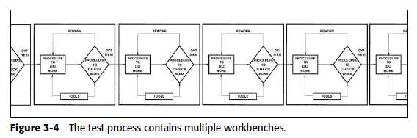

Slide 20
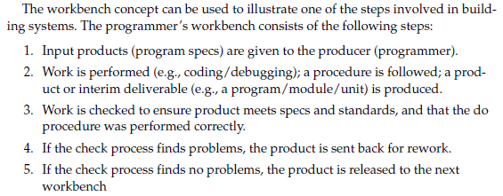

Slide 21
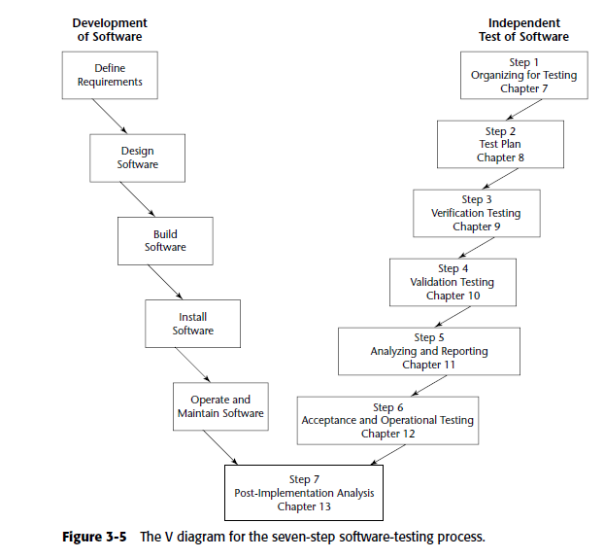

Slide 22
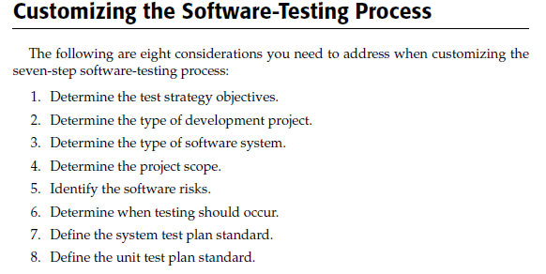

Slide 23
Determining the Test Strategy Objectives
What is the ranking of the test factors?
Which of the high-level risks are the most significant?
What damage can be done to the business if the software fails to perform Correct
What is the ranking of the test factors?
Which of the high-level risks are the most significant?
What damage can be done to the business if the software fails to perform correctly?

Slide 24
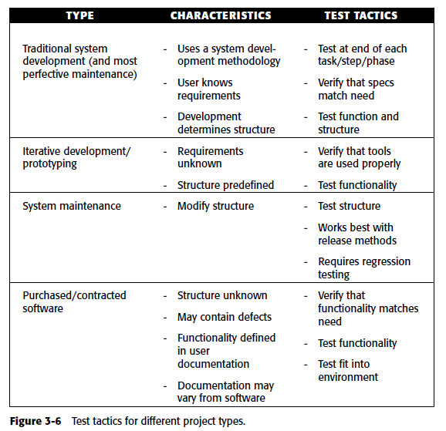

Slide 25
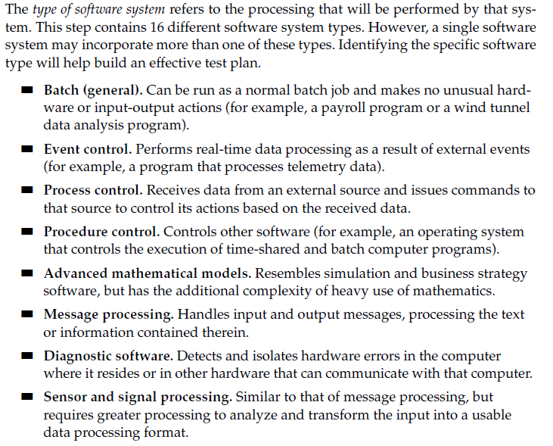

Slide 26
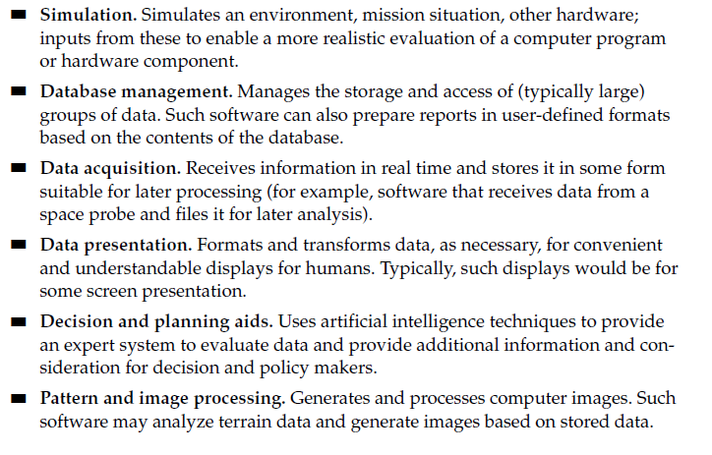

Slide 27
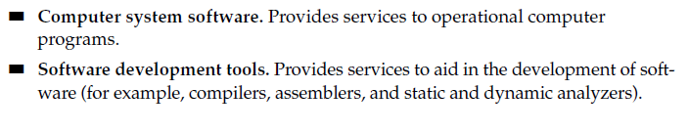

Slide 28

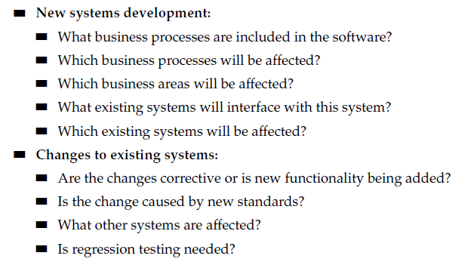

Slide 29
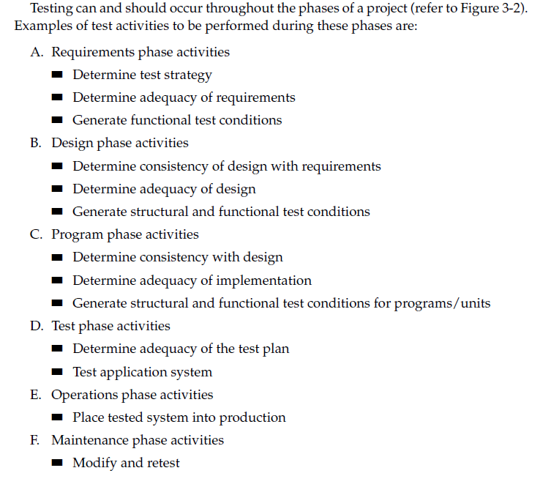

Slide 30
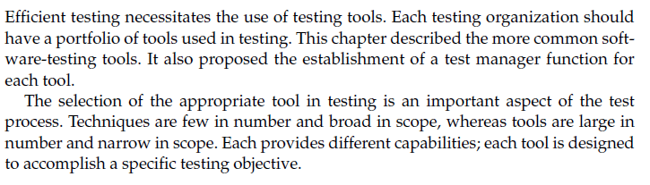

Slide 31
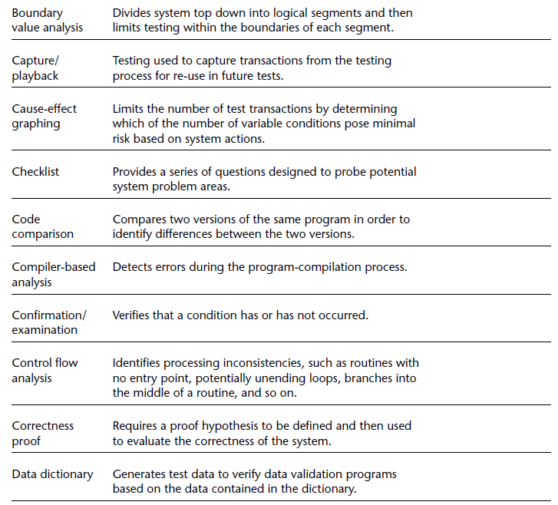

Slide 32
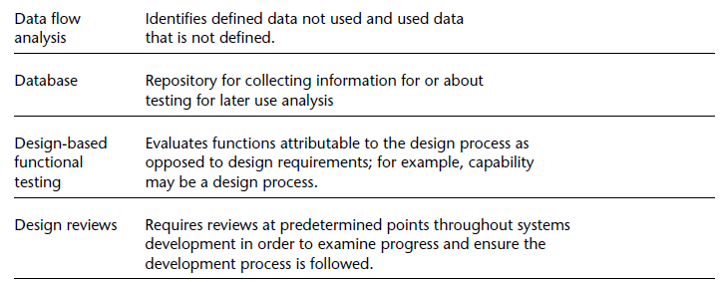

Slide 33
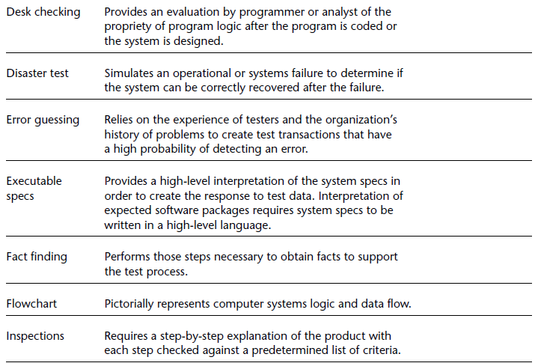

Slide 34
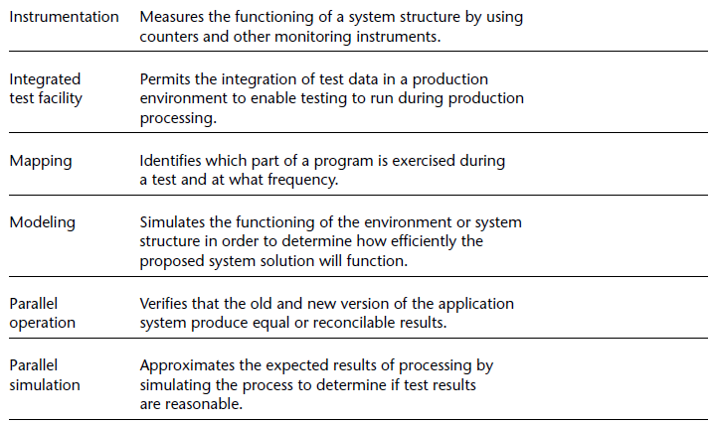

Slide 35
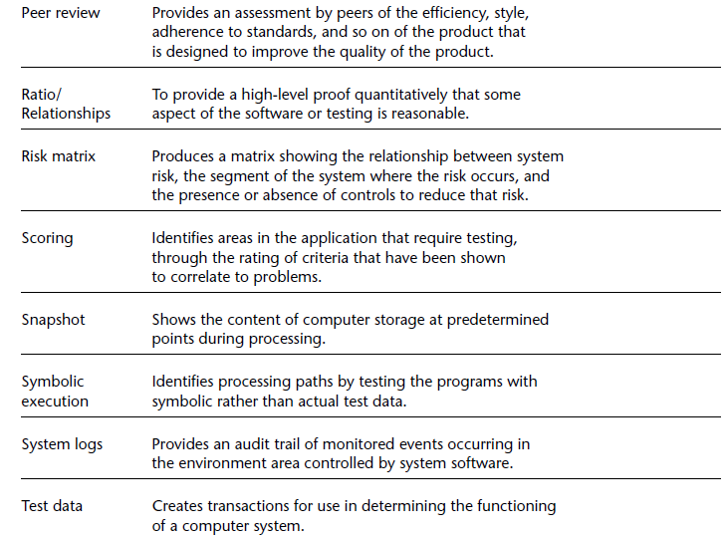

Slide 36
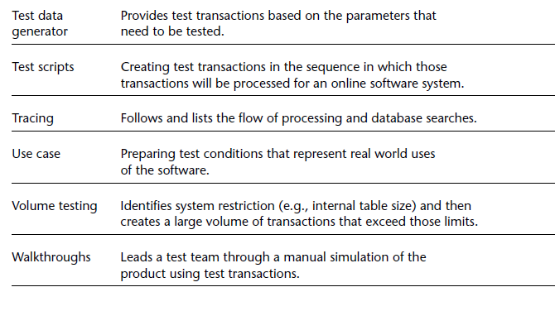

Slide 37
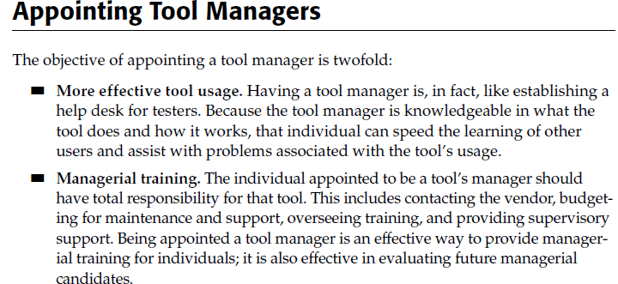

Slide 38
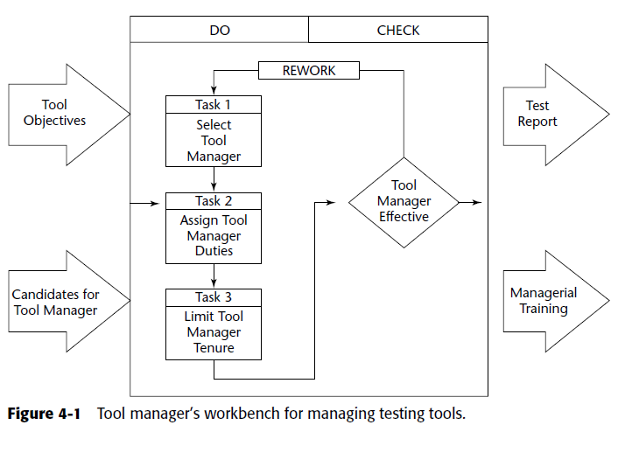

Slide 39
Selecting a Tool Manager
Ideally, the tool manager should be selected during the process of selecting the tool, and have ownership in the selection decision.
The tool manager should possess the following:
Training skills
Tool skills
Managerial skills
Planning
Organizing
Directing
Controlling

Slide 40
Thank You

